Slide 1
Empirical Estimation Models
It uses empirically derived formulas to predict effort as a function of LOC or FP.
In decomposition techniques, LOC or FP is calculated using tables, but in Empirical Estimation Models, the resultant values of LOC or FP are directly put in the models.

Slide 2
Structure of Estimation Models
An estimation model is derived using regression analysis on data collected from past projects
Overall structure takes the form:-
E=A+B*(e_{v})^{C}

Slide 3
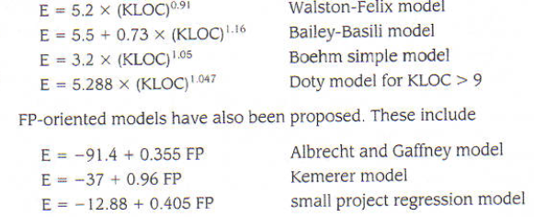
Structure of Estimation Models
Example:-

Slide 4
COCOMO - 1
COnstructive Cost MOdel
COCOMO is one of the most widely used software estimation models in the world
It was developed by Barry Boehm in 1981
COCOMO predicts the effort and schedule for a software product development based on inputs relating to the size of the software and a number of cost drivers that affect productivity

Slide 5
Types of Software Projects
Software development project can be classified into the following categories based on the development complexity:
Organic
Semidetached
Embedded

Slide 6
Contd…
Organic: If the project deals with developing a well understood application program, small development team and team members are experienced in developing similar types of projects.
Semidetached: If the development consists of a mixture of experienced and inexperienced staff. Team members may have limited experience on related systems but may be unfamiliar with some aspects of the system being developed.
Embedded: If the software being developed is strongly coupled to complex hardware, or if the stringent regulations on the operational procedures exist.

Slide 7
The Development Modes: Project Characteristics
Organic Mode
developed in a familiar, stable environment,
similar to the previously developed projects
relatively small and requires little innovation
Semidetached Mode
intermediate between Organic and Embedded
Embedded Mode
tight, inflexible constraints and interface requirements
The product requires great innovation

Slide 8
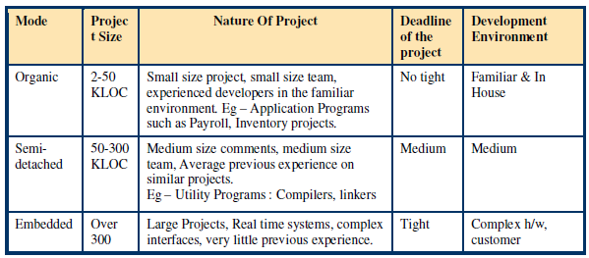
Contd…

Slide 9
COCOMO: Some Assumptions
Primary cost driver is the number of Delivered Source Instructions (DSI) or KLOC developed by the project
COCOMO estimates assume that the project will enjoy good management by both the developer and the customer
Assumes the requirements specification is not substantially changed after the plans and requirements phase

Slide 10
COCOMO
Software cost estimation should be done in three stages:-
Basic COCOMO
Intermediate COCOMO
Complete COCOMO or Detailed Model

Slide 11
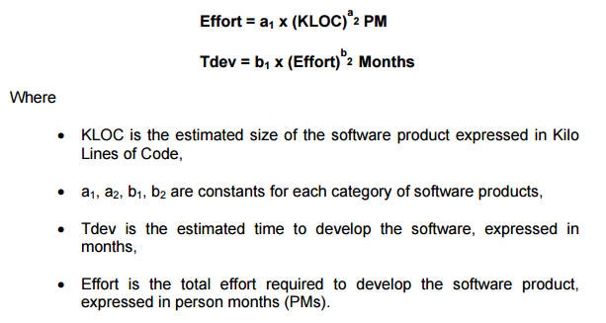
Basic COCOMO
It gives an approximate estimate of project parameters
It is given by the following expressions:-

Slide 12
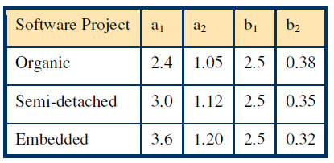
Contd…

Slide 13
Basic COCOMO Model
Basic COCOMO model estimates the software development effort using only a single predictor variable (size in DSI) and three software development modes

Slide 14
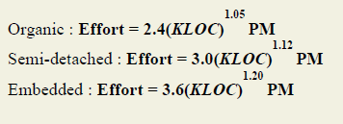
Estimation of Effort

Slide 15
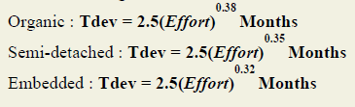
Estimation of Development Time

Slide 16
Basic COCOMO Model: Equations
Notes:
Effort in man-months
A COCOMO man-month consists of 152 hours of working time
KDSI is the Thousand Delivered Source Instructions
TDEV is the number of months estimated for software development

Slide 17
Basic COCOMO Model: An Example
Q) We have determined our project fits the characteristics of Semi-Detached mode. We estimate our project will have 32,000 Delivered Source Instructions.
Find Effort, Schedule, Productivity, and average staffing required for the project.
Solution:
Using the formulas, we can estimate:
Effort = 3.0*(32) ^{1.12}
= 146 man-months
Schedule = 2.5*(146) ^{0.35}
= 14 months
Productivity = 32,000 DSI / 146 MM = 219 DSI/MM
Average Staffing = 146 MM /14 months = 10 FSP
(FSP means Full-time-equivalent Software Personnel)
Notes:
FSP = Full-time equivalent Software Personnel, a measure of the equivalent number of people working on the project at a given time.

Slide 18
Example:
A System with 100,000 LOC has to be developed. Find the effort and development time for each of the three development modes: organic, semidetached and embedded.

Slide 19
Basic COCOMO Model: When Should You Use It
Basic COCOMO is good for quick, early, rough order of magnitude estimates of software costs

Slide 20
Intermediate COCOMO Model
Four areas for drivers
Product itself:
inherent complexity of the product, reliability requirements etc.
Computer:
execution speed required, storage space required, etc.
Personnel:
experience level, programming capability, analysis capability, etc.
Project itself or Development environment:
development facilities available to developers

Slide 21
Intermediate Model: Cost Driver Categories
Product Attributes
RELY --- Required Software Reliability
The extent to which the software product must perform its intended functions satisfactorily over a period of time.
DATA --- Data Base Size
The degree of the total amount of data to be assembled for the data base.
CPLX --- Software Product Complexity
The level of complexity of the product to be developed.
Notes:
RELY --- Required Software Reliability DATA --- Data Base Size CPLX --- Software Product Complexity

Slide 22
Cost Driver Categories
Computer Attributes
TIME --- Execution Time Constraint
The degree of the execution constraint imposed upon a software product.
STOR --- Main Storage Constraint
The degree of main storage constraint imposed upon a software product.
VIRT --- Virtual Machine Volatility
The level of the virtual machine underlying the product to be developed.
TURN --- Computer Turnaround Time
The level of computer response time experienced by the project team developing the product.

Slide 23
Cost Driver Categories
Personnel Attributes
ACAP --- Analyst Capability
The level of capability of the analysts working on a software product.
AEXP --- Applications Experience
The level of applications experience of the project team developing the software product.
PCAP --- Programmer Capability
The level of capability of the programmers working on the software product.
VEXP --- Virtual Machine Experience
LEXP --- Programming Language Experience

Slide 24
Cost Driver Categories
Project Attributes
MODP --- Modern Programming Practices
The degree to which modern programming practices (MPPs) are used in developing software product.
TOOL --- Use of Software Tools
The degree to which software tools are used in developing the software product.
SCED --- Required Development Schedule
The level of schedule constraint imposed upon the project team developing the software product.

Slide 25
Contd…
Constant values for Intermediate COCOMO
Software Project | a1 | a2 | b1 | b2
Organic | 3.2 | 1.05 | 2.5 | 0.38
Semi-detached | 3.0 | 1.12 | 2.5 | 0.35
Embedded | 2.8 | 1.20 | 2.5 | 0.32

Slide 26
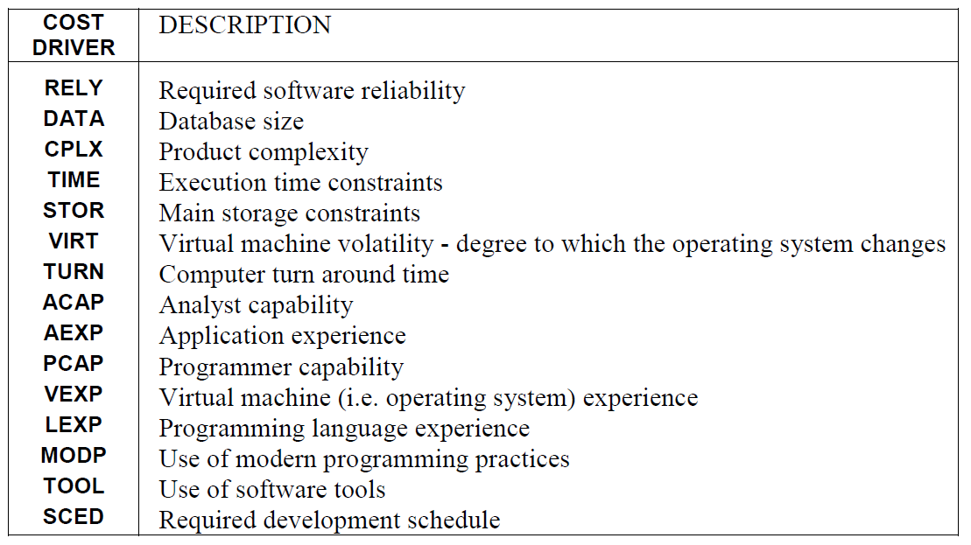

Slide 27
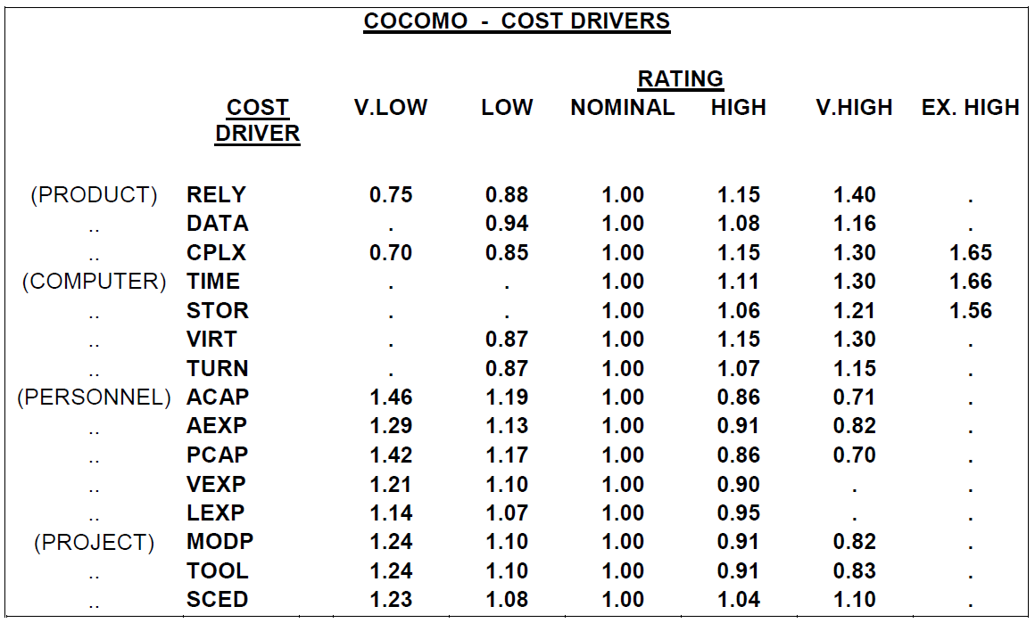

Slide 28
Intermediate Model: An Example
q)Project A is to be a 32,000 DSI semi-detached software. It is in a mission critical area, so the reliability is high (RELY=high=1.15). Then we can estimate:
Solution:
Effort = 3.0*(32)^{1.12} *1.15 = 167 man-months
Schedule = 2.5*(167)^{0.35} = 15 months
Productivity = 32,000 DSI/167 MM = 192 DSI/MM
Average Staffing = 167 MM/15 months = 11 FSP

Slide 29
Example:
As an example of how the intermediate COCOMO model works, the following is a calculation of the estimated effort for a semi-detached project of 56 KLOC. The cost drivers are set as follows:
Product cost drivers- high
Computer cost drivers – nominal
Personnel cost drivers - low
Project cost drivers high
Solution:
Product cost drivers (from the table) set high = 1.15 x 1.08 x 1.15 = 1.43
Computer cost drivers (from the table) set nominal = 1.00
Personnel cost drivers (from the table) set low = 1.19 x 1.13 x 1.17 x 1.10 x 1.07 = 1.85
Project cost drivers (from the table) set high = 0.91 x 0.91 x 1.04 = 0.86
product(cost drivers) = 1.43 x 1.00 x 1.85 x 0.86 = 2.28

Slide 30
Contd…
product(cost drivers) = 1.43 x 1.00 x 1.85 x 0.86 = 2.28
For a semi-detached project of 56KLOC: a = 3.0 b = 1.12 S = 56
E = a(S)b x product(cost drivers)
E = 3.0 x (56)^1.12 x 2.28
E = 3.0 x 90.78 x 2.28
E = 620.94 person-months

